Slide 1
Maths workshop
Fluency in action: Times tables as the gateway to problem solving
Becoming fluent in Mathematics:
‘Quick and efficient recall of facts and procedures and the flexibility to move between different contexts and representations of mathematics’.

Slide 2
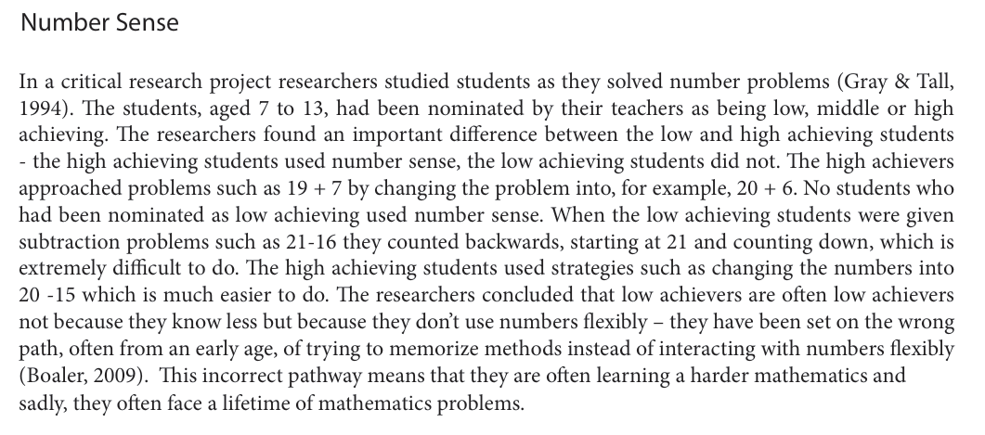



Fluency-Without-Fear-1.28.15.pdf

Slide 3
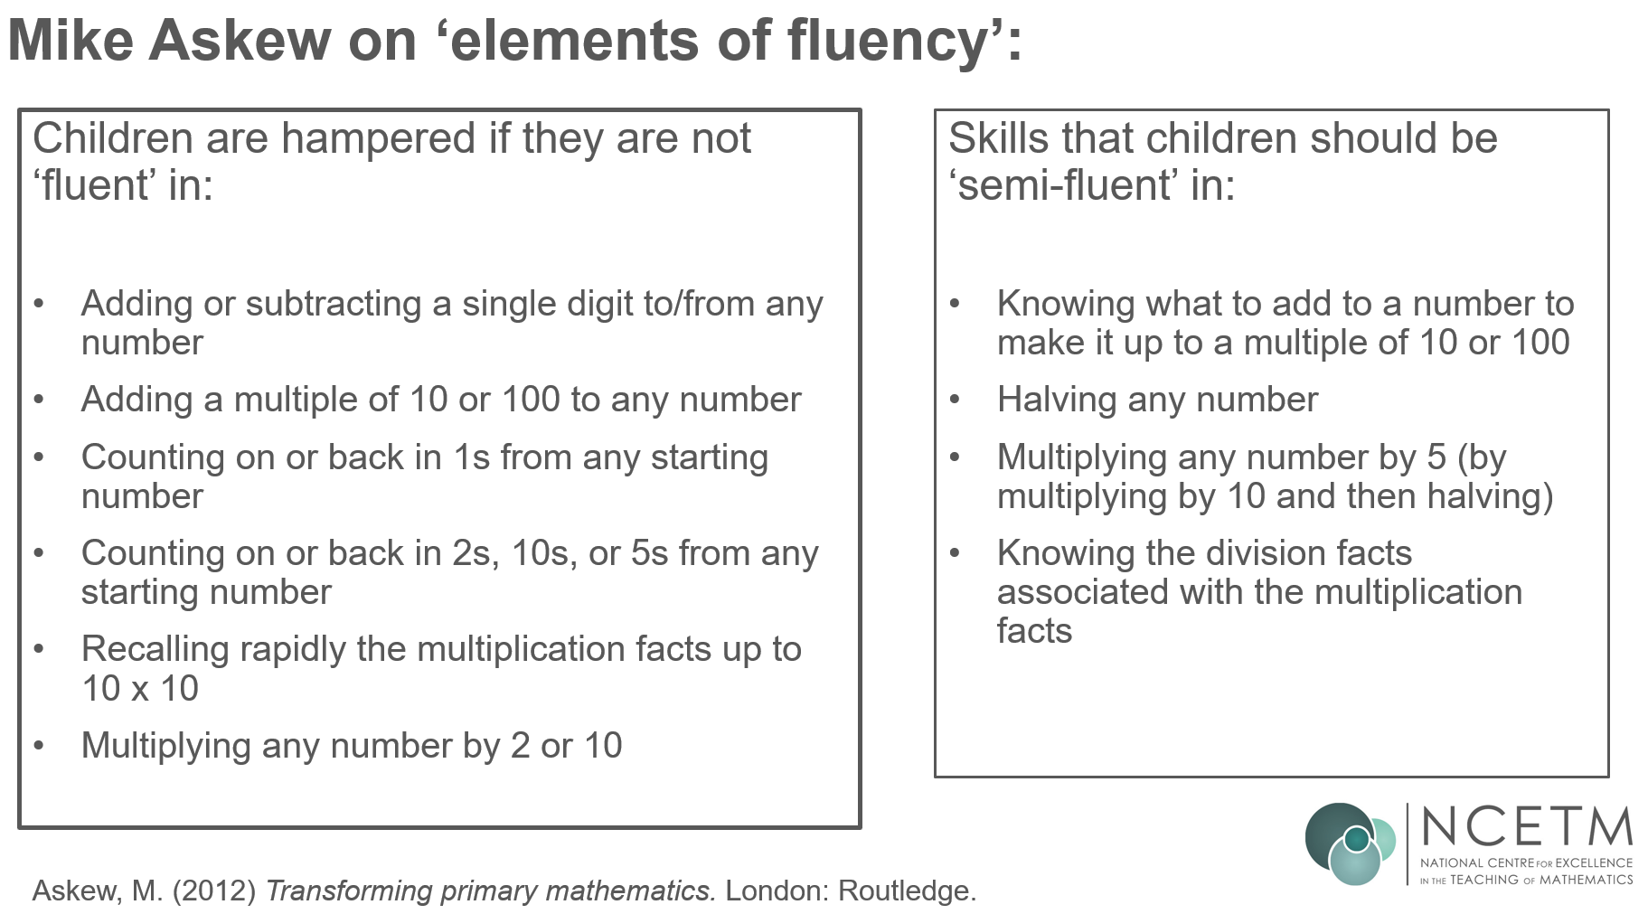

Slide 4
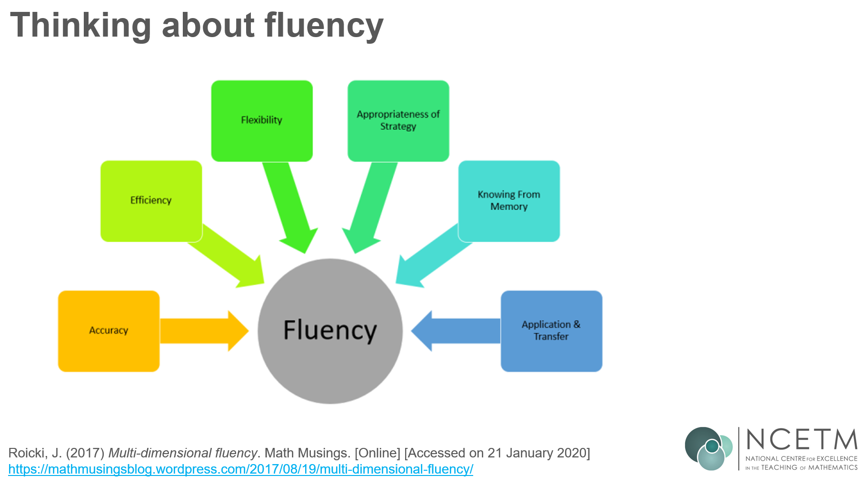

Slide 5
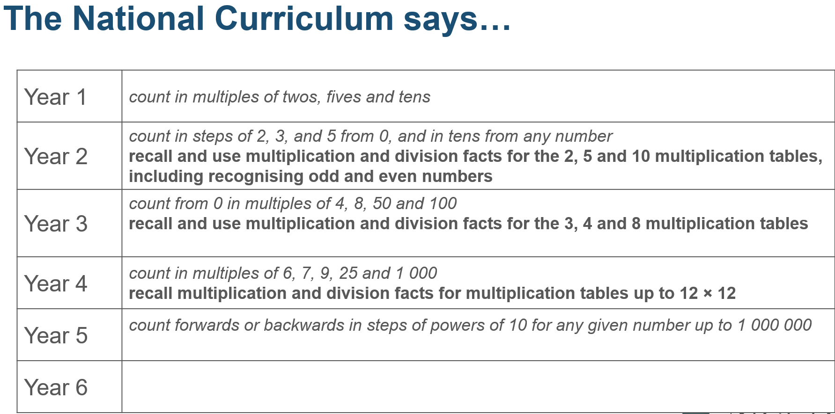

Slide 6
Mike Askew on ‘mindful learning’:
“While much of mathematics learning needs to be mindful … some things are best done fairly automatically. If you know that eight add two is ten, then the door is open to exploring some mathematics that involves adding numbers to ten. If, on the other hand, you still need to count in ones from eight to ten then your attention, your mindfulness, is going to be taken up with the counting and you could lose sight of what you were aiming for.”
Askew, M. (2012) Transforming primary mathematics. London: Routledge.

Slide 7
Mike Askew on the purpose of being ‘fluent’:
“Learning the tables still seems to be one of those ‘hot potatoes’ or touchstones in mathematics education. Your answer to ‘do children need to learn their tables?’ is a marker of whether you are a ‘progressive educator’ or a believer in ‘back to basics’. Both of these miss the point of being fluent in [multiplication tables]. They treat knowing these as an end in themselves. But the point of being fluent in them is to free up the working memory when tackling a more interesting and engaging piece of mathematics.”
Askew, M. (2012) Transforming primary mathematics. London: Routledge.

Slide 8
Examples of a maths talk topic
What is the odd one out and why?
4, 9, 12
True or false:
11 x 8 = 10 x 8 + 11
If I know 3 x 4 what other facts can I work out?
How could you represent 7 x 5?

Slide 9
Our challenges
In light of the Year 4 times table test…
To avoid purely teaching multiplication facts as something to be memorised.
To teach multiplication facts so that pupils gain conceptual understanding of the mathematics and make connections.
To value depth of understanding over speed.

Slide 10
Key Considerations
Fluency demands more of learners than memorisation of a single procedure or collection of facts. It encompasses a mixture of efficiency, accuracy and flexibility.
Quick and efficient recall of facts and procedures is important in order for learners to keep track of sub-problems, think strategically and solve problems.
Fluency also demands the flexibility to move between different contexts and representations of mathematics, to recognise relationships and make connections, and to make appropriate choices from a whole toolkit of methods, strategies and approaches.
Notes:
A summary of the key considerations for this session.

