Slide 1


Slide 2



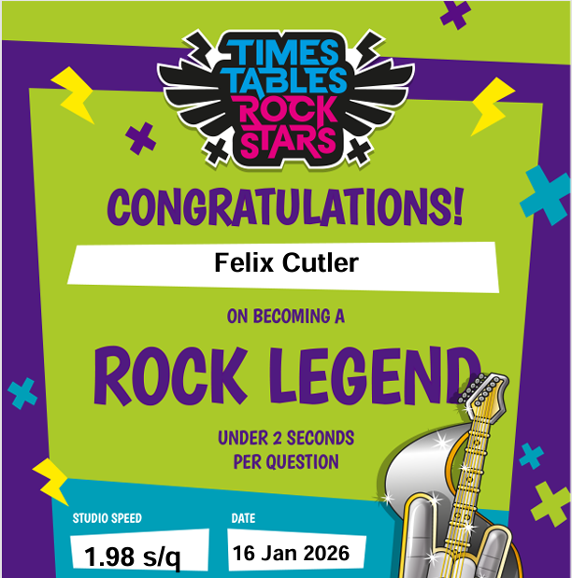


Slide 3
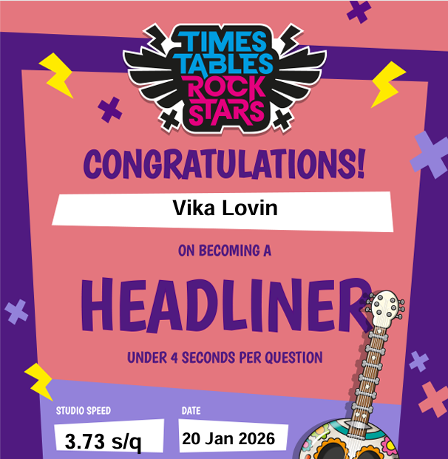

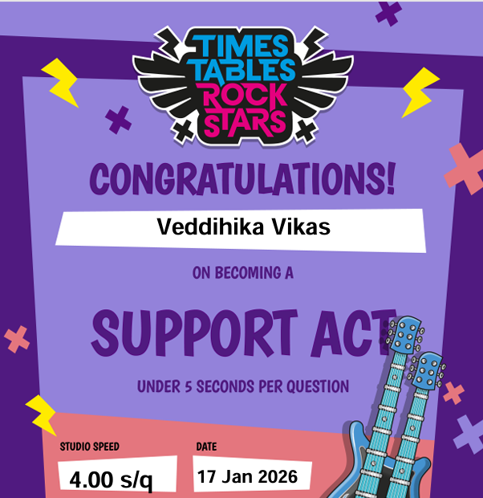
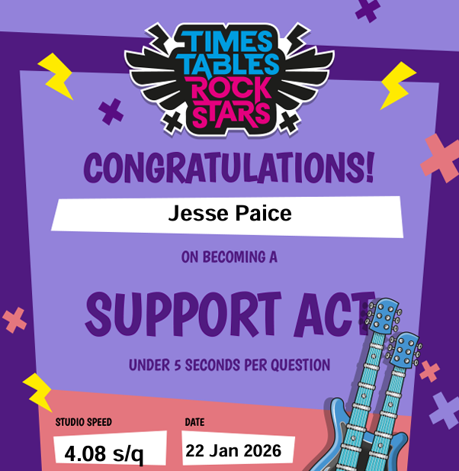
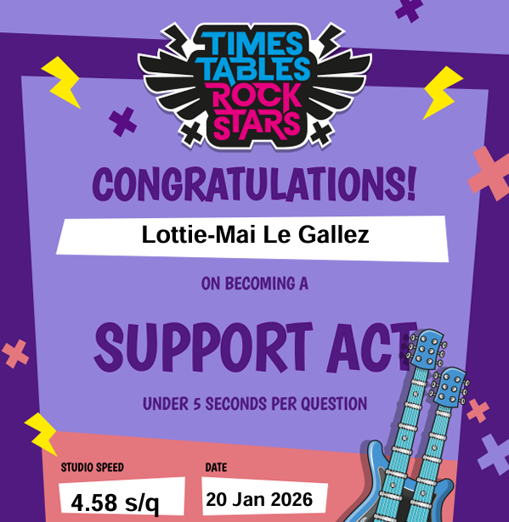
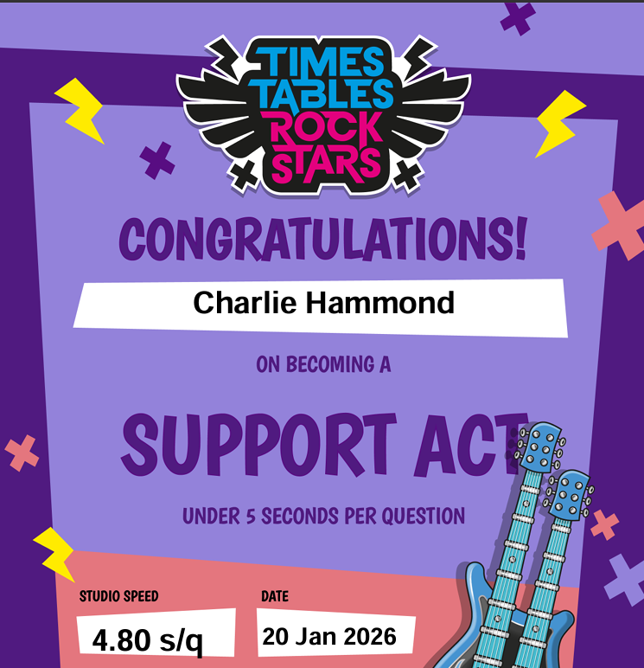
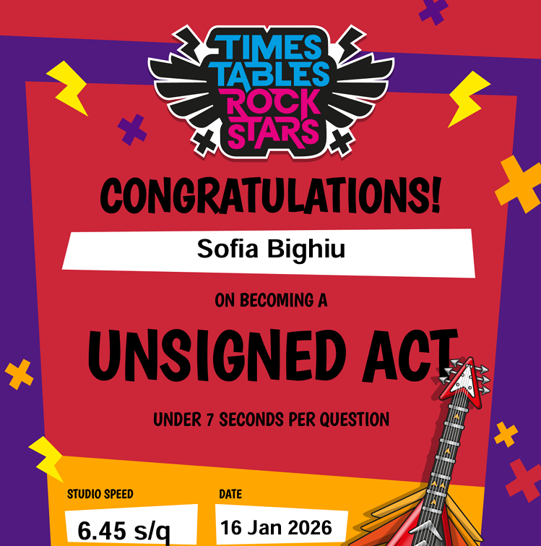
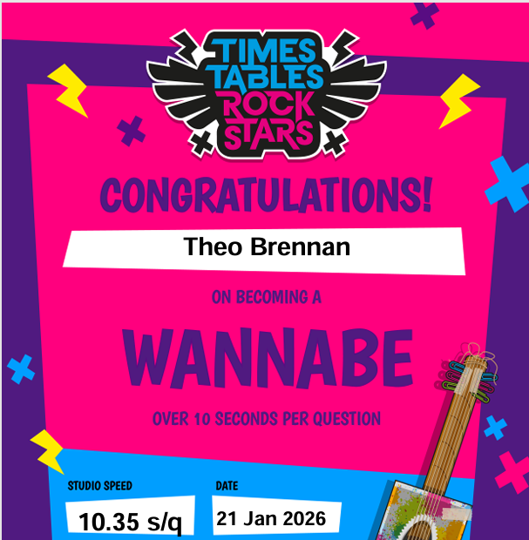

Slide 4
Winners for Friday 23.1.26
Highest percentage (%) players.
The class with the most players active is…

Slide 5
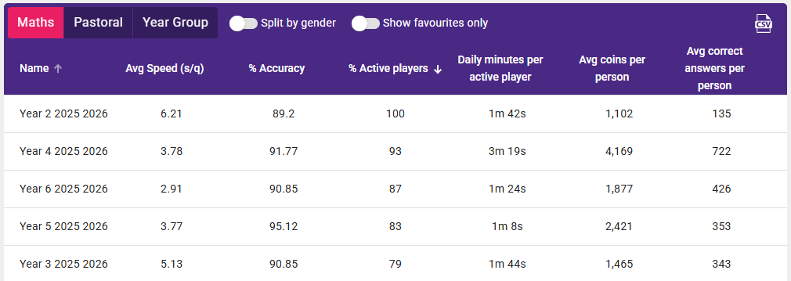






23.1.26

Slide 6






23.1.26

Slide 7
23.1.26

Slide 8
23.1.26

Slide 9
23.1.26

Slide 10
23.1.26

Slide 11
Next week’s competition parameters:
Daily minutes per active player

