Slide 1
Top 5 Active Participants on Mathletics
Monday 17th – Sunday 23rd
Year 2 | Year 3 | Year 4 | Year 5 | Year 6
Earl | Freddie L | Aaron | Riley | Darina
Jalahni | Maxwell | felix | Ethan | Lacey
Lona | Zosia | Eva | Ellie | Arina
Ceci | Violet | Yuna | Fran | Jessica
Freddie | Jesse | Barney | Diana | Chloe

Slide 2
Top 5 Active Participants on Mathletics
Monday 24th – Sunday 30th
Year 2 | Year 3 | Year 4 | Year 5 | Year 6
Earl | Freddie L | Barney | Meena | Lacey
Chloe | Maxwell | Kit | Ethan | Darina
Jessica | Jesse | Robyn | Will T | Oscar
Emily | Zosia | Yuna | Michal | Hanna
Lona | Isabelle | Sol | Sophia | Willow

Slide 3

Top 5 Active Participants on Mathletics
Monday 1st Dec– Sunday 7th Dec
Year 2 | Year 3 | Year 4 | Year 5 | Year 6
Lona | Freddie L | Barney | Will T | Lacey
Earl | Zosia | Layla | Diana | Oliver
Tiffany | Lottie | Robyn | Willow | Darina
Jalahni | Evie-Leigh | Yuna | Benji | Aeris
Arthur | Maxwell | Aaron | Sophia | Mimi

Slide 4
Top 5 Active Participants on Mathletics
Monday 8st Dec– Sunday 14th Dec
Year 2 | Year 3 | Year 4 | Year 5 | Year 6
Jack T | Freddie L | Barney | Benji | Diana
Arthur | Ethan | Felix | Ethan | Lacey
Eva | Zosia | Ela | Will T | Betsy
Chloe | Hanna | Aaron | Yana | Chloe
Lola | Maxwell | Layla | Diana | Evie
Spin the Wheel – Free and easy-to-use random picker. Add names or options, spin to decide. Save and share instantly.

Slide 5
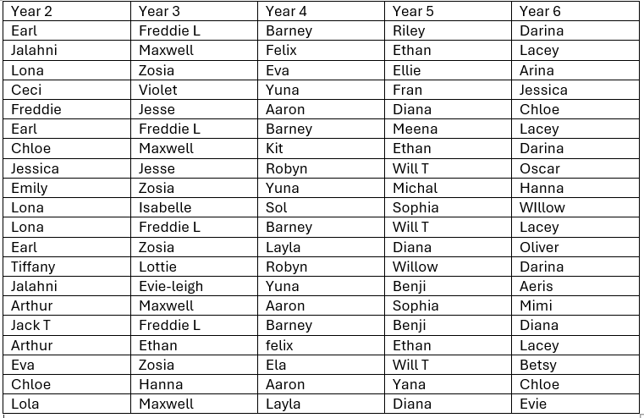

Slide 6


