Slide 1


Slide 2


Slide 3
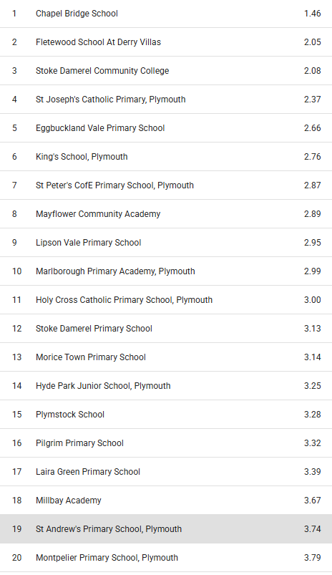
St. Andrew’s CofE
19 out of 30 in Plymouth
(Only Year 4/5/6 count towards the average)
No.1
Chapel Bridge School
1.46 seconds per question
No.19
St. Andrew’s CofE
3.74 seconds per question

Slide 4



Slide 5


Slide 6


Slide 7


Slide 8


Slide 9


Slide 10


Slide 11


Slide 12
Cue the Music
Jump
By Van Halen

Slide 13



Slide 15


Slide 17



Slide 19


Slide 21




Slide 23




Slide 25


Slide 27

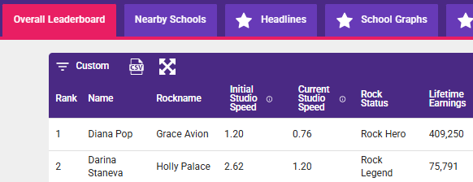

Slide 28
Winners for Friday 6.2.26
% Accuracy (with at least 80% active users)
The class with the most players active is…

Slide 29
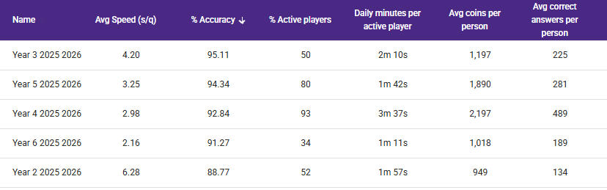
6.2.26

Slide 30
6.2.26

Slide 31
6.2.26

Slide 32
6.2.26

Slide 33
Next week’s competition parameters:
Best average speed per question (minimum 80% active players)

