Slide 1


Slide 2
Cue the Music
Jump
By Van Halen

Slide 3






Slide 4


Slide 5
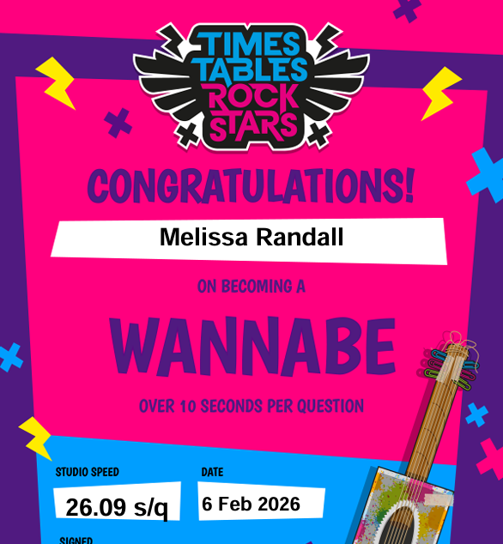
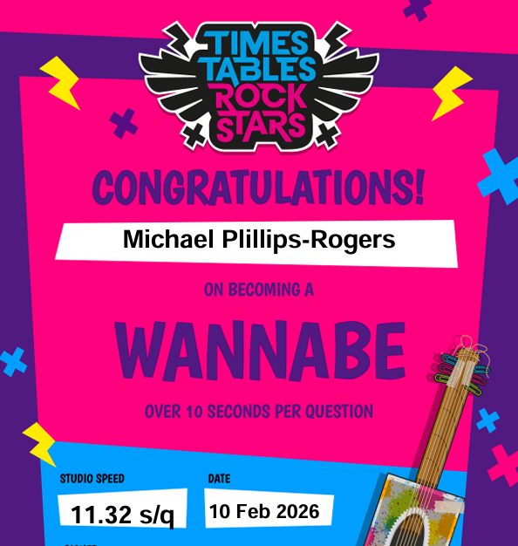

Slide 6


Slide 7
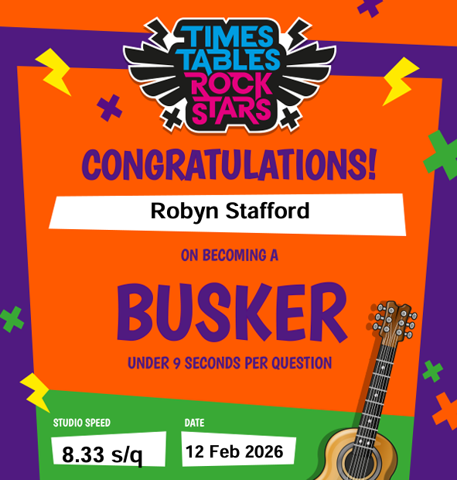

Slide 8


Slide 9


Slide 10


Slide 11


Slide 12


Slide 13

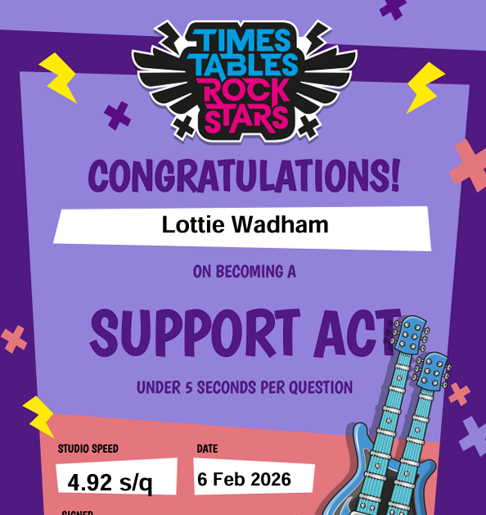

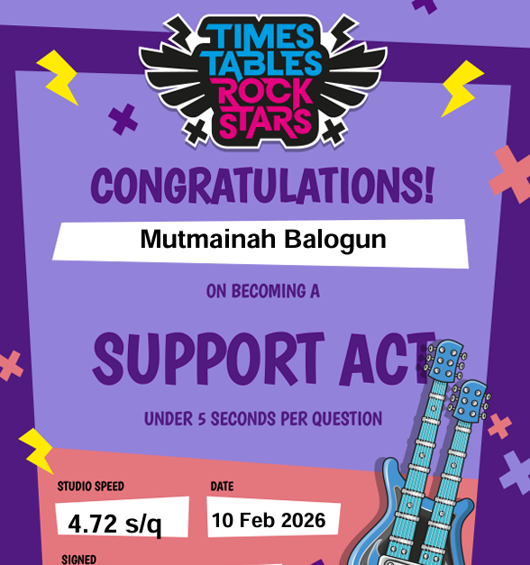

Slide 14


Slide 15




Slide 16


Slide 17

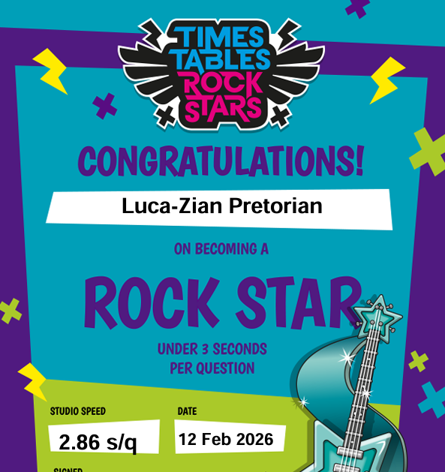
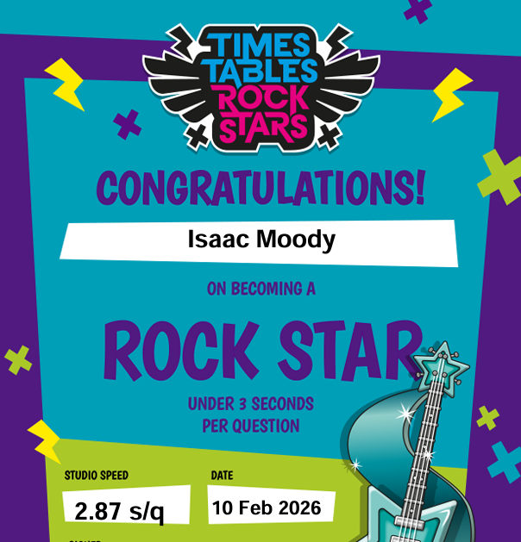

Slide 18


Slide 19
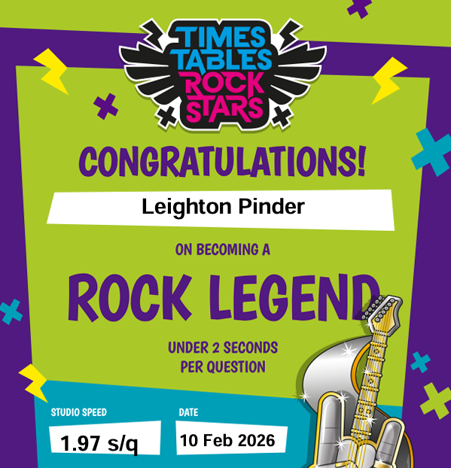
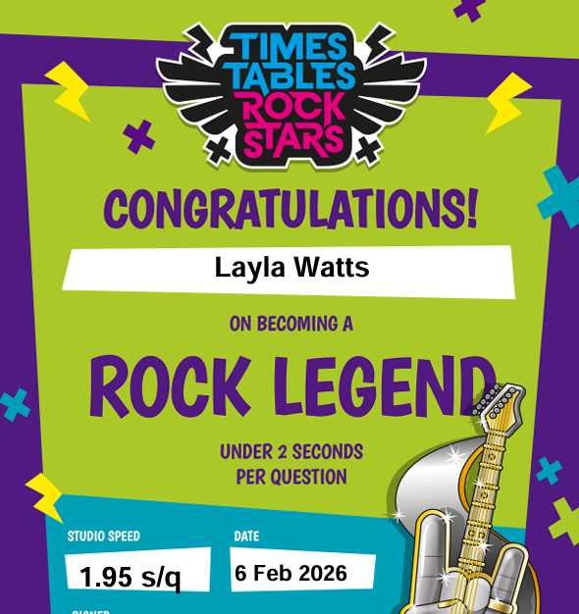
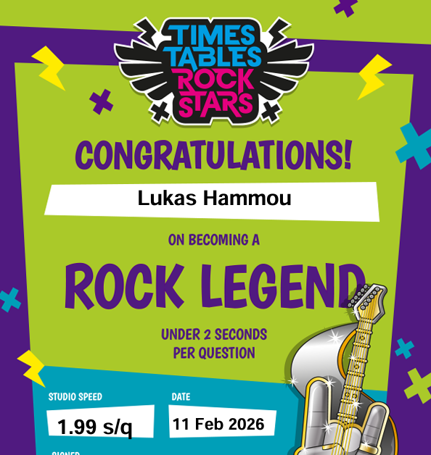

Slide 20
Winners for Friday 14.2.26
Ave Speed per question (with at least 80% active users)

Slide 21
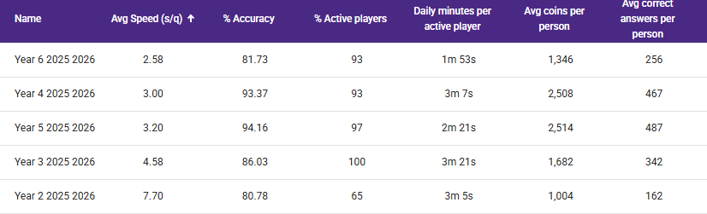
14.2.26

Slide 22
14.2.26

Slide 23
14.2.26

Slide 24
14.2.26

