Slide 1
Welcome to Year 6
17.9.26

Slide 2
Routines
Expectations
SATs
Secondary Transitions
Sailing
Residential

Slide 3
Routines
8.35 – doors open and learning starts (Spelling or Arithmetic)
8.45 – Register taken
8.55 – registration closes
9.00 to 9.25 – Basic skills learning session

Slide 4
Expectations
Attendance / 8.35
Social Media
Reading books
Uniform, P.E. kit
Water bottles
Toilet breaks
Active learners
Homework
Phones

Slide 5
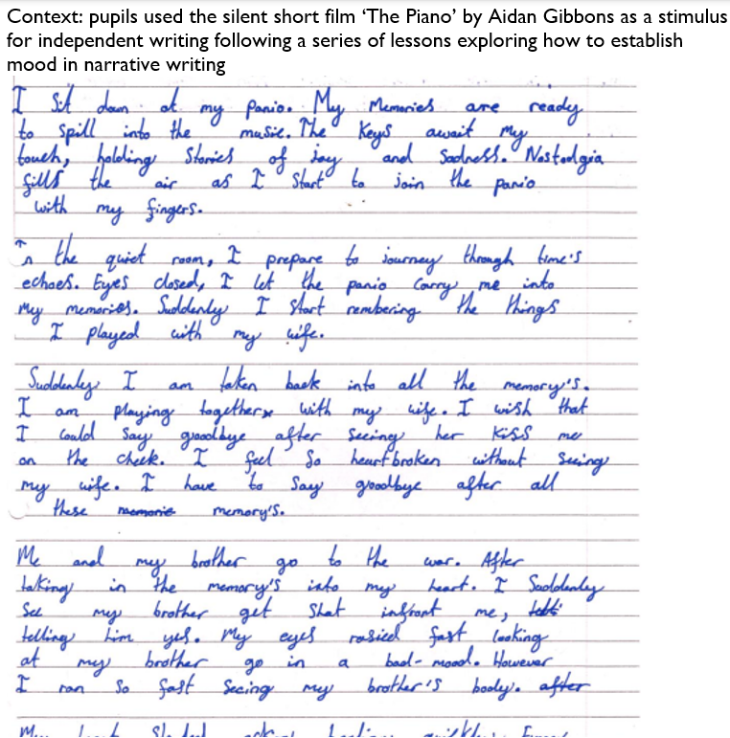
Expectations - Writing

Slide 6
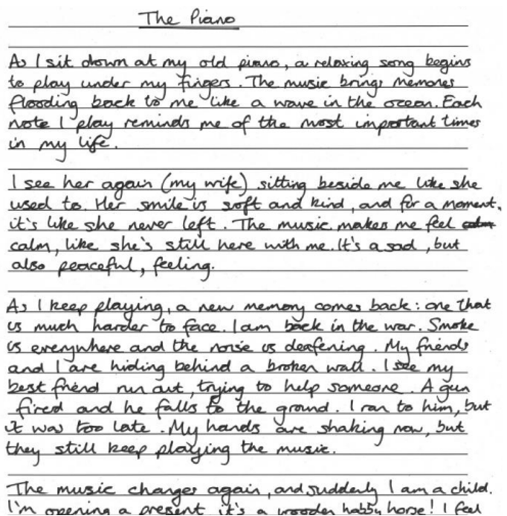
Expectations - Writing

Slide 7
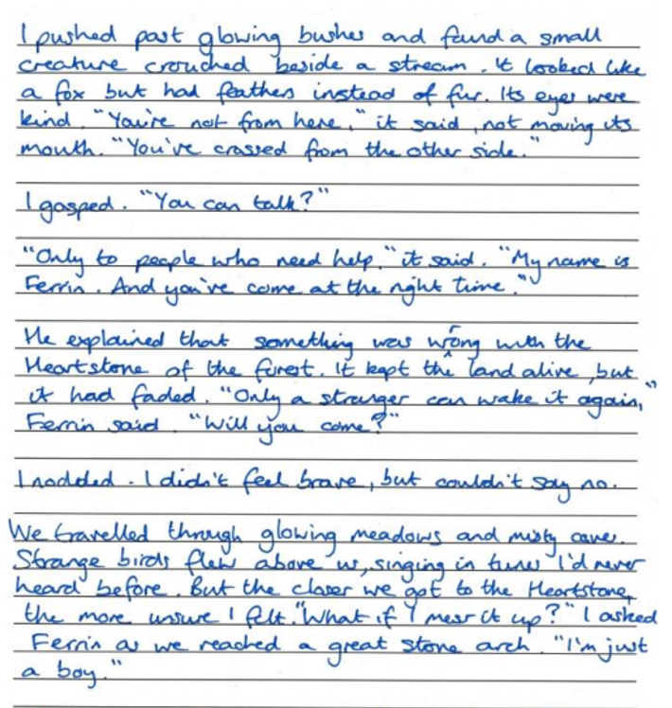
Expectations - Writing

Slide 8
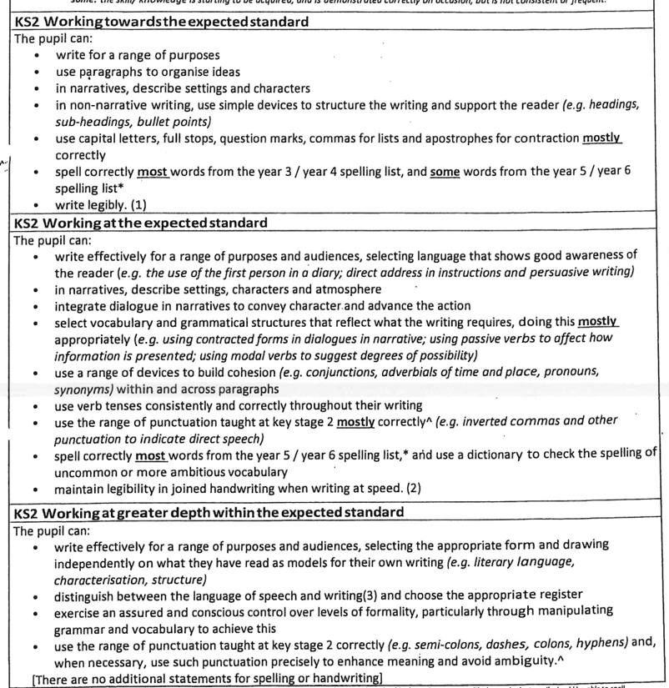

Slide 9
Expectations - Maths

Slide 10
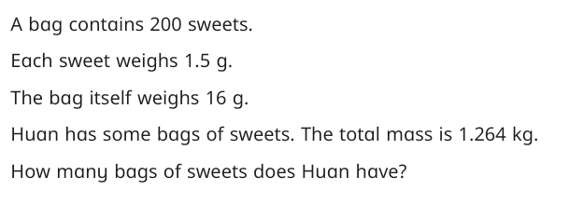
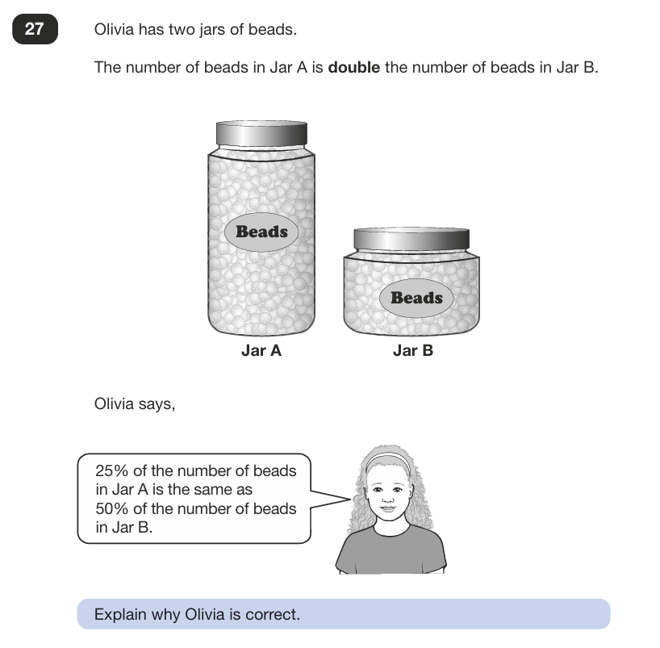

Slide 11
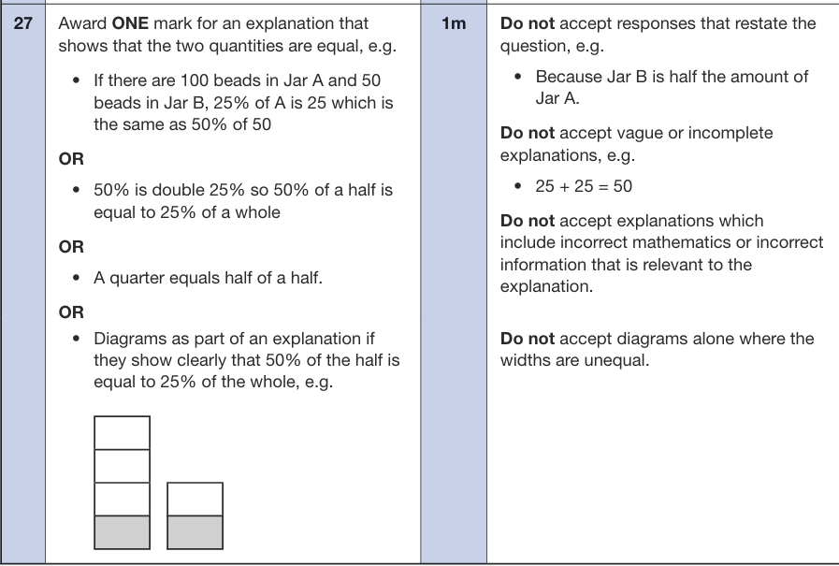




Slide 12
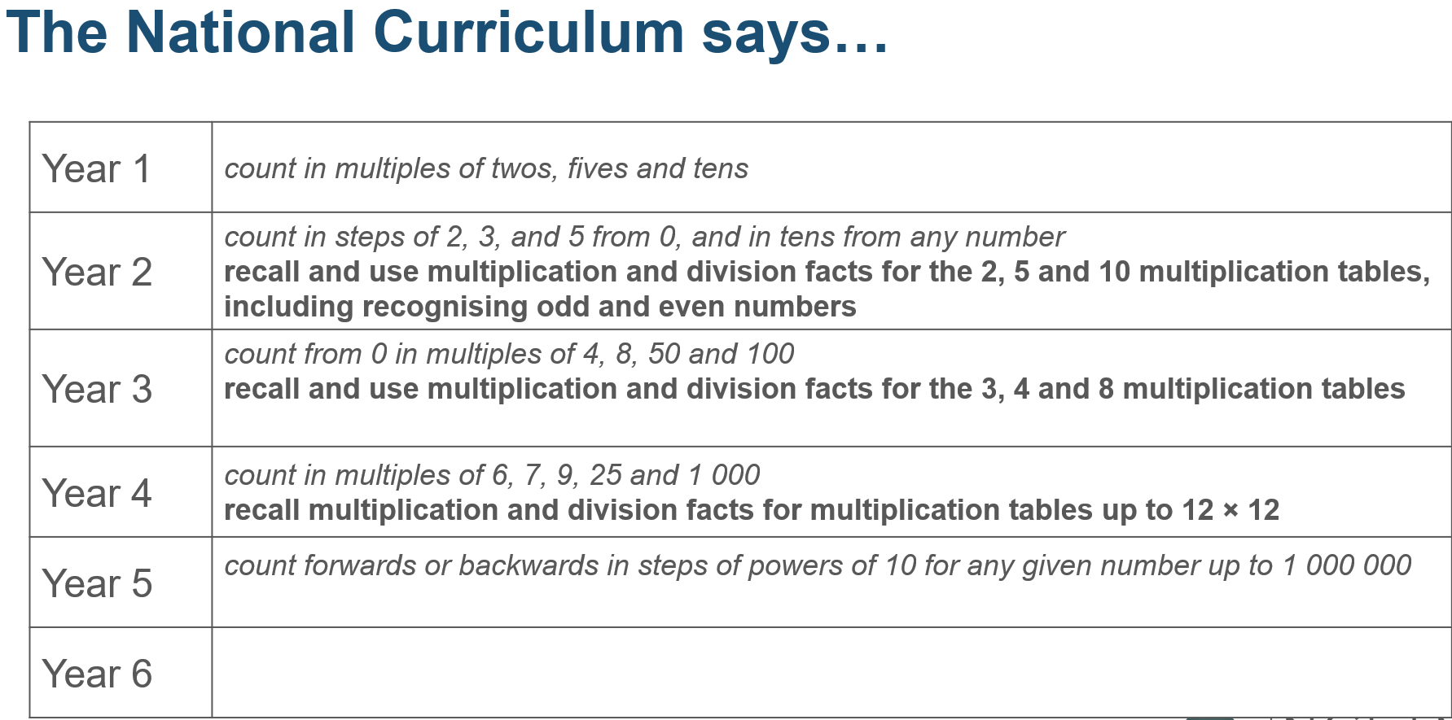

Slide 13
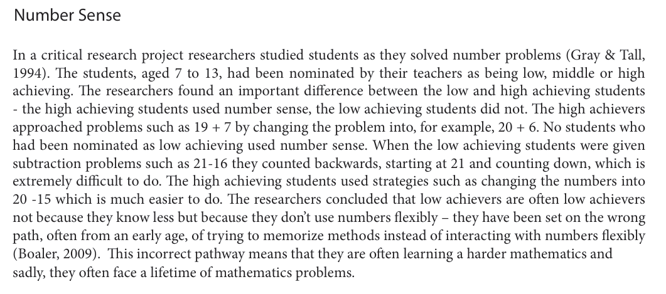



Fluency-Without-Fear-1.28.15.pdf
Implications?

Slide 14
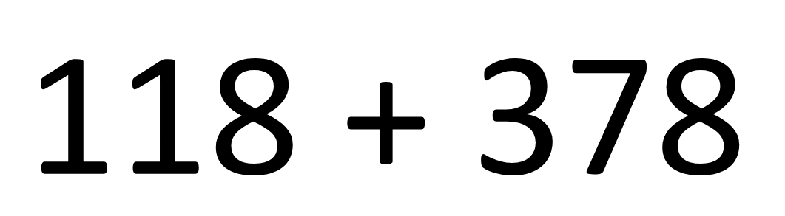

Slide 15
Mike Askew on the purpose of being ‘fluent’:
“Learning the tables still seems to be one of those ‘hot potatoes’ or touchstones in mathematics education. Your answer to ‘do children need to learn their tables?’ is a marker of whether you are a ‘progressive educator’ or a believer in ‘back to basics’. Both of these miss the point of being fluent in [multiplication tables]. They treat knowing these as an end in themselves. But the point of being fluent in them is to free up the working memory when tackling a more interesting and engaging piece of mathematics.”
Askew, M. (2012) Transforming primary mathematics. London: Routledge.
Notes:
He continues…
Knowing multiplication facts is not an end in itself.
Having known facts frees up working memory.

Slide 16
SATs
Monday, May 10th to Thursday, May 15th, 2027.
Monday – SPaG (40 mins) and Spelling
Tuesday - Reading (1hr)
Wednesday – Arithmetic (30 mins) and Reasoning 1 (40 mins)
Thursday – Reasoning 2 (40 mins)
Scaled scores
2026 key stage 2 scaled score conversion tables - GOV.UK
Writing – End of June

Slide 17
Secondary Transitions
Open days
Deadline: 31st October 2026
Allocation: 1st March 2026
Portal
Secondary Schools rarely visit now
Enhanced transitions (I.E.Ps)
Plymouth-wide transitions: 7th/8th July, except Stoke
Enhanced transitions for those with I.E.Ps / EHCPs. Very limited space.

Slide 18
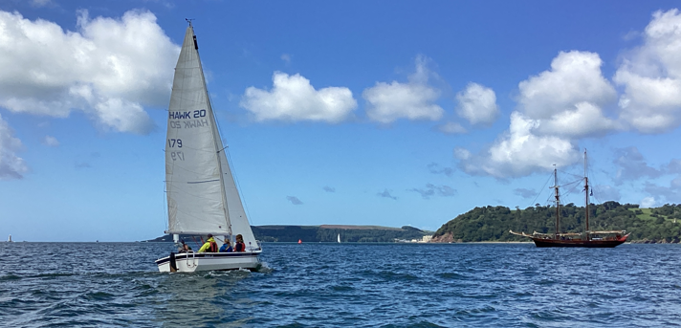
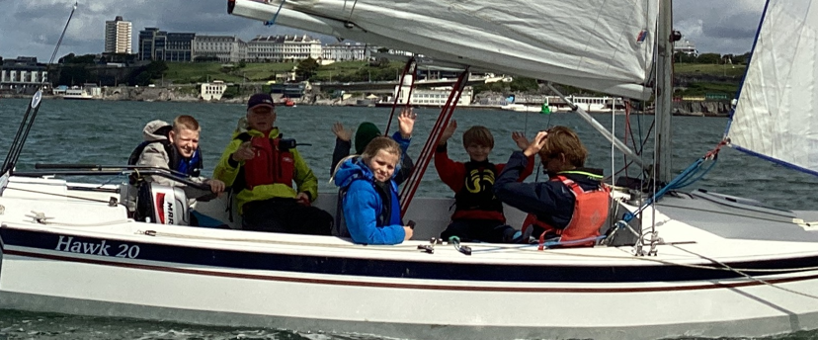
Sailing

Slide 19
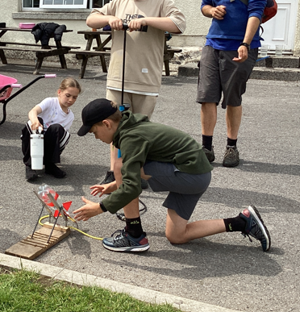
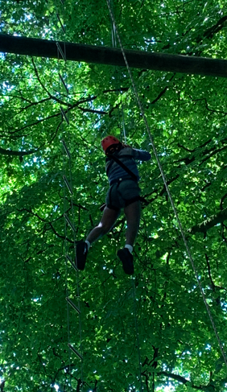
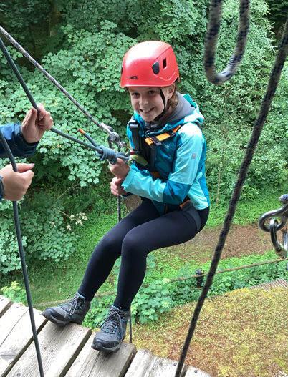
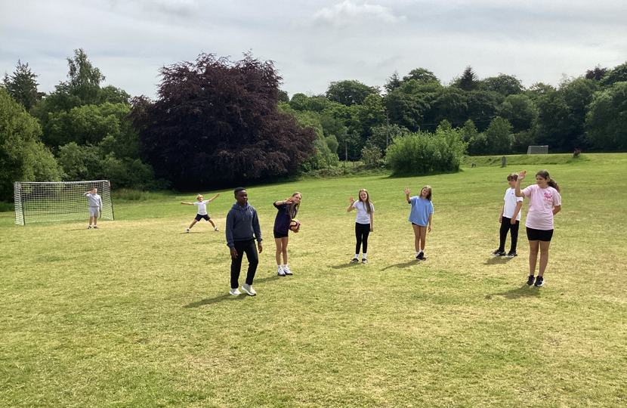
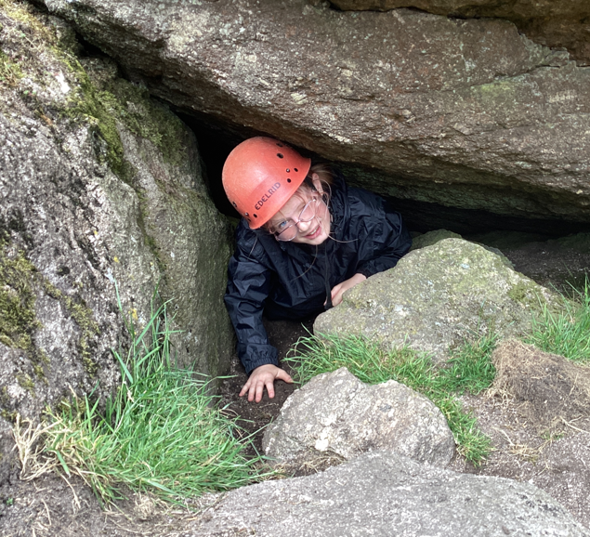
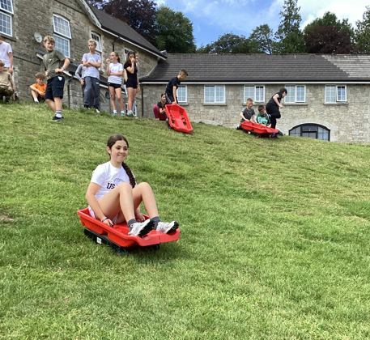
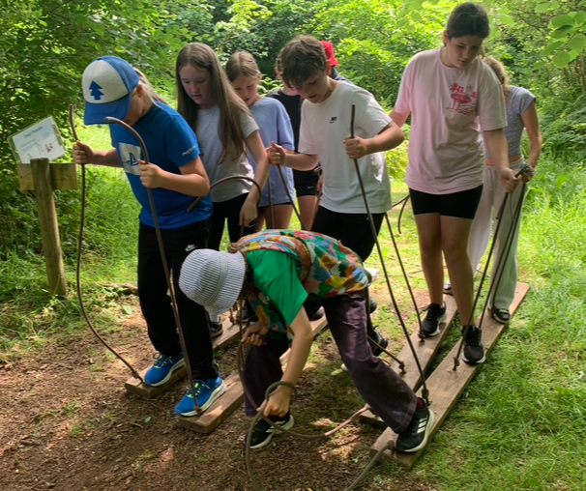
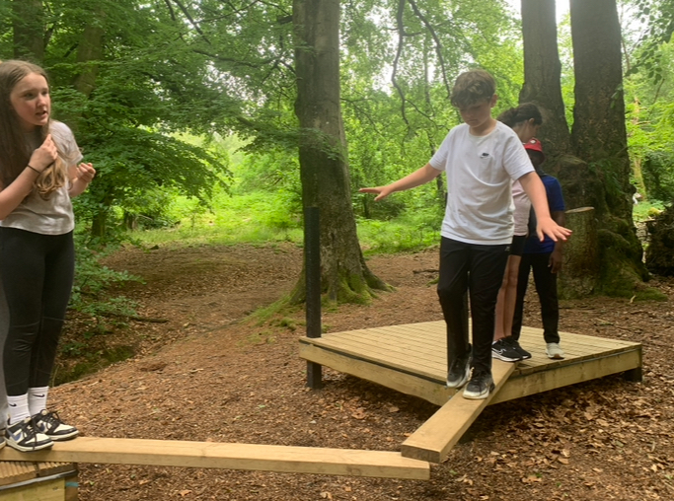
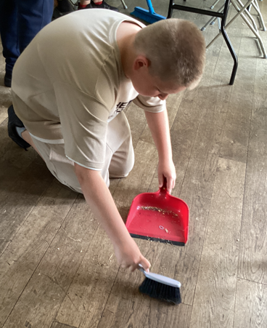
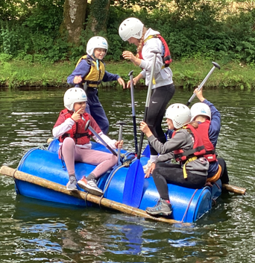
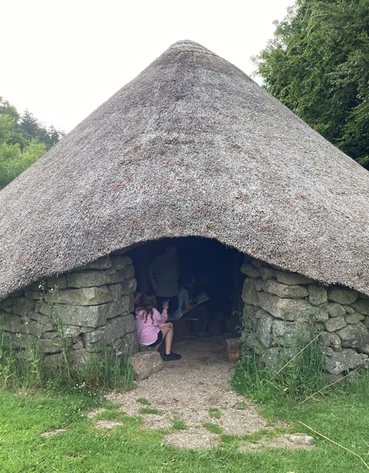
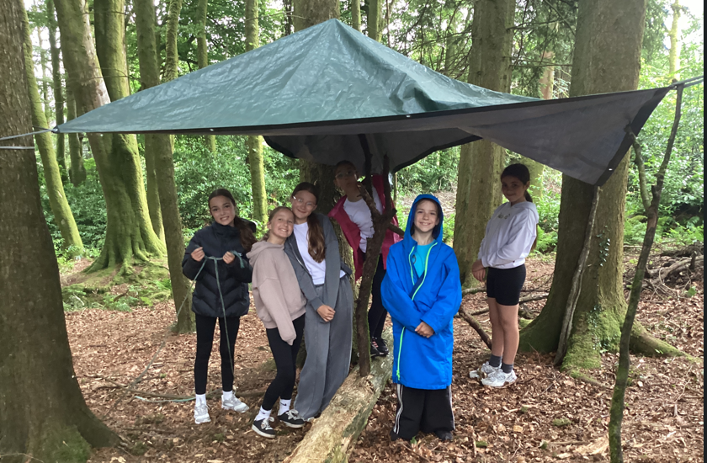
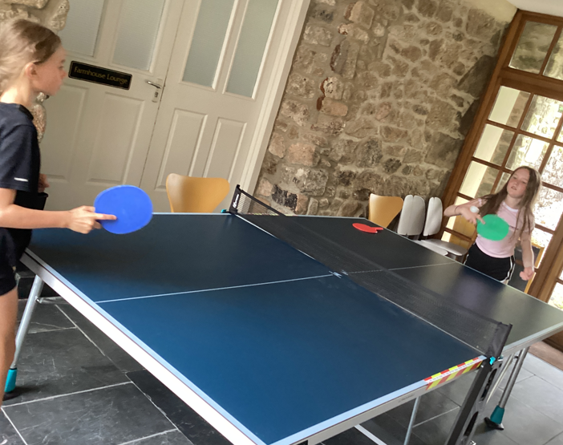
Residential: Leave 5th October - return 9th October
Heatree Activity Centre – Bringing Dartmoor to Life

Slide 20
Questions

